Slide 1
test
LINCOLN DOUGLAS
and TEAM POLICY DEBATE
ORIENTATION

Slide 7
TEST
LINCOLN DOUGLAS DEBATE
One student per team
Debaters define, analyze, and argue value propositions.
Round lasts 40 minutes.
TEAM POLICY DEBATE
Two students per team
Debaters propose and argue reforms to US policies.
Round lasts 75 minutes.

Slide 8
LINCOLN DOUGLAS DEBATE

Slide 9
LINCOLN DOUGLAS Oct-Jan Resolution
Resolved:
A free press ought to prioritize objectivity over advocacy.

Slide 10
Notes:
Presenters: please give an example of a value and resolution in your own words (note: don’t use the current resolution).

Slide 11
LINCOLN DOUGLAS ROUND STRUCTURE

Slide 12
LINCOLN DOUGLAS

Slide 13
Per the 2023-2024 LD Rules: All forms of support are valid but the judge should place greater weight on philosophical and logical arguments made over specific applications or evidence in deciding on the big picture idea.

Slide 14
TEAM POLICY DEBATE

Slide 15
TEAM POLICY 2023-2024 Resolution
Resolved:
The United States federal government should substantially reform its energy policy.

Slide 16
TEAM POLICY ROUND STRUCTURE

Slide 17
TEAM POLICY

Slide 19
COMMON TO BOTH LD AND TP DEBATE

Slide 24
IN TEAM POLICY
BETWEEN SPEECHES
Each LD debater has a total of 4 minutes. Each TP team has a total of 5 minutes.

Slide 28
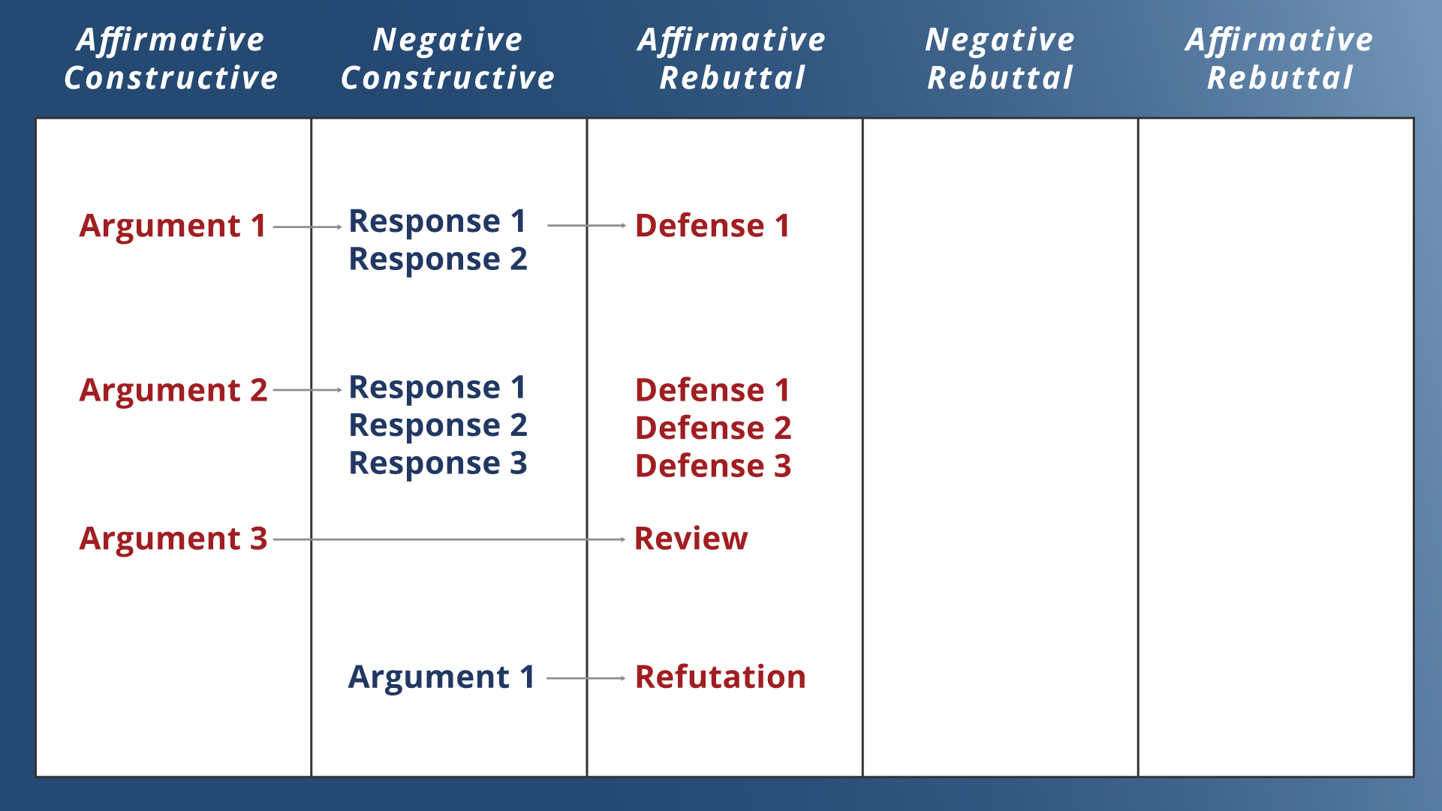

Slide 35
LINCOLN DOUGLAS INDIVIDUAL EVALUATIONS

Slide 36
TEAM POLICY INDIVIDUAL EVALUATIONS

